Slide 1

Intramolecular Vibrational Modes in Excitation Energy Transfer and Spectroscopy of Molecular Aggregates
March 3rd, 2021
Tomáš Mančal
Charles University, Prague, Czech Republic

Slide 2
What is This Talk about?

Slide 3
Excitation energy transfer in photosynthesis
Quantum revolution in photosynthesis (2007 and on)
Intramolecular vibrations: spectroscopy
  Long lived oscillations
Intramolecular vibrations: excitation energy transfer
  Ultrafast energy transfer across large energy gaps
  Detraping from low energy states
Energy transfer meets spectroscopy

Slide 4
A very biased selection of literature
[1] P. Malý, V. I. Novoderezhkin, R. van Grondelle, T. Mančal, Electron-vibrational coupling decreases trapping by low-energy states in photosynthesis, Chem. Phys. 522 (2019) 69; DOI: 10.1016/j.chemphys.2019.02.011
[2] J. Seibt, and T. Mančal, Ultrafast energy transfer with competing channels: Non-equilibrium Foerster and Modified Redfield theories, J. Chem. Phys. 146 (2017) 147109; DOI: 10.1063/1.4981523
[3] V. Perlík, J. Seibt, L. J. Cranston, R. J. Cogdell, C. N. Lincoln, J. Savolainen, F. Šanda, T. Mančal, J. Hauer, Vibronic coupling explains the ultrafast carotenoid-to-bacteriochlorophyll energy transfer in natural and artificial light harvesters, J. Chem. Phys. 142 (2015) 2012434; DOI: 10.1063/1.4919548 (arXiv:1502.06271)
[4] T. Mančal, J. Dostál, J. Pšenčík, and D. Zigmantas, Transfer of Vibrational Coherence Through Incoherent Energy Transfer Process in Förster Limit, Can. J. Chemistry 92 (2014) 135; DOI: 10.1139/cjc-2013-0351
[5] A. Chenu, N. Christensson, H. K. Kauffmann and T. Mančal, Enhancement of Vibronic and Ground-State Vibrational Coherences in 2D Spectra of Photosynthetic Complexes, Sci. Rep. 3 (2013) 2029; DOI: 10.1038/srep02029, (arXiv:1211.4397v1)
[6] N. Christensson, H. F. Kauffmann, Tonu Pullerits and T. Mančal, Origin of Long-Lived Coherences in Light-Harvesting Complexes, J. Phys. Chem. B 116 (2012) 7449; DOI: 10.1021/jp304649c, (arXiv:1201.6325v1)
[7] T. Mančal, N. Christensson, V. Lukes, F. Milota, O. Bixner, H. F. Kauffmann and J. Hauer, System-dependent Signatures of Electronic and Vibrational Coherences in Electronic 2D-Spectra, J. Phys. Chem. Lett. 3 (2012) 1494; DOI: 10.1021/jz300362k
[8] A. Nemeth, F. Milota, T. Mančal, V. Lukeš, H. Kauffmann and J. Sperling, Vibronic modulation of lineshapes in two-dimensional electronic spectra, Chem. Phys. Lett. 459 (2008) 94; DOI: 10.1016/j.cplett.2008.05.057

Slide 5
Excitation Energy Transfer in Photosynthesis:
Traditional View

Slide 6
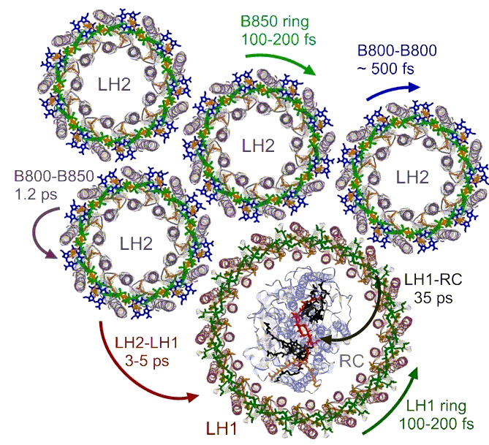
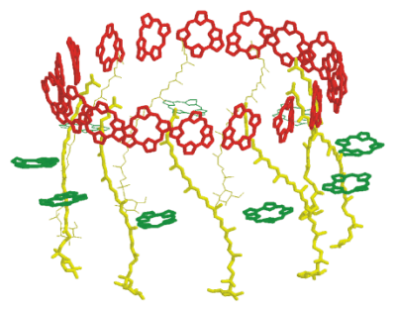
Energy Transfer in
(Photosynthetic) Molecular Aggregates
Photosynthetic antennae – e.g. LH1/RC, LH2

Slide 7
Space and Energy
Domain Transfers
Simplification into exciton transfer problem
How is this physics?

Slide 8
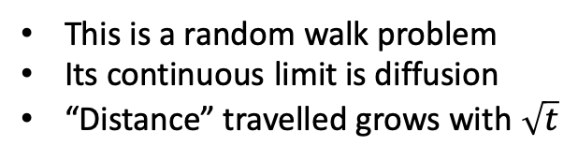
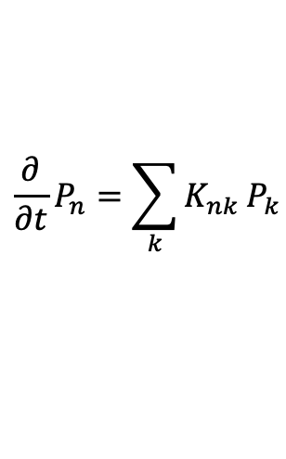
Spatial Energy Transfer
Naïve formulation of the problem
Sites connected by energy transfer rates
K₃₁
This is a random walk problem
Its continuous limit is diffusion
“Distance” travelled grows with $\sqrt{t}$
6
$$\frac{∂}{∂t}P_{n}=\sum_{k}{K_{nk}}P_{k}$$
K₅₃
1
3
5
2
4
Where does this apply?
Between antennae complexes
Between individual weakly coupled molecules

Slide 9
Spatial Energy Transfer: Energy Conservation Law
Energy transfer between weakly coupled pigments
Förster resonance energy transfer: second order perturbation theory
Fermi Golden rule
Donor
Acceptor
The essence of photo-synthetic
energy transfer!

Slide 10
Spatial Transfer between Complexes
Energy transfer between two antennae
First complication
Simple Förster resonance energy transfer (FRET)
does not work!
FRET requires overlap of donor fluorescence and acceptor
absorption
The bands are too far apart
But energy transfer occurs – the solution is the collective character of antenna states

Slide 11
Energy/Frequency Domain Transfer
Collective antenna states
Donor
Acceptor
Strong coupling
2 x excited
1 x excited
2 x resonance coupling
0 x excited

Slide 12
Bigger Picture of Excitation Energy Transfer
Usual antennae – collection of delocalized and localized states
Strong coupling
Localized states -
individual bacteriochlorophylls
Delocalized
states
Weak coupling
Weak coupling

Slide 13
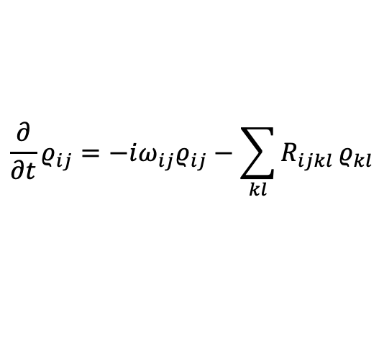
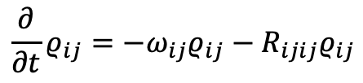
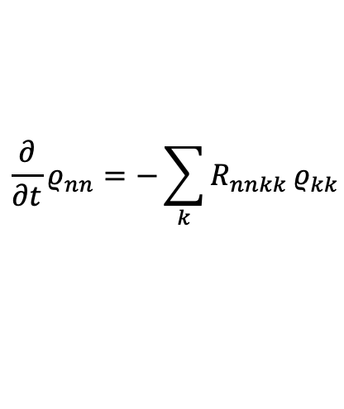
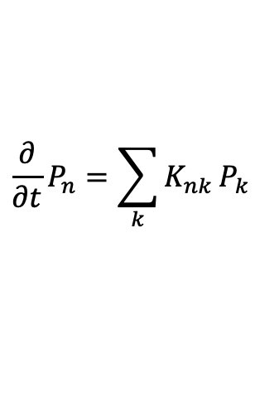


Standard Toolbox: Master Equations
Energy transfer in strongly coupled aggregate
Strong coupling
Yes, if we think in terms of aggregate/antenna
eigenstates:
$$\frac{∂}{∂t}ρ_{ij}=−iω_{ij}ρ_{ij}−\sum_{kl}{R_{ijkl}}ρ_{kl}$$
Energy transfer does not occur in space
Spatially distinct states cannot be excited
by light
Secular approximation
$$\frac{∂}{∂t}ρ_{nn}=−\sum_{k}{R_{nnkk}}ρ_{kk}$$
$$\frac{∂}{∂t}ρ_{ij}=−ω_{ij}ρ_{ij}−R_{ijij}ρ_{ij}$$
Does
$$\frac{∂}{∂t}P_{n}=\sum_{k}{K_{nk}}P_{k}$$
make any sense here?
Energy transfer
Dephasing of coherence
$$K_{nk}=−R_{nnkk}$$
$$γ_{ij}=R_{ijij}$$

Slide 14
System Bath Interaction: Problem of Basis
Site basis
Exciton basis
2 approaches, 2 limits
Weak System-bath coupling
Relaxation between eigenstates of the Hamiltonian H_{el} (excitonic or delocalizeb basis)
Energy gap correlation function

Slide 15
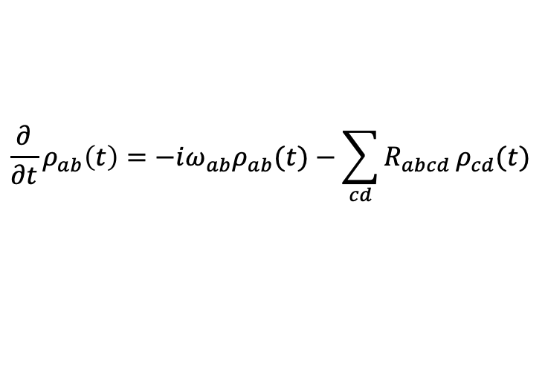
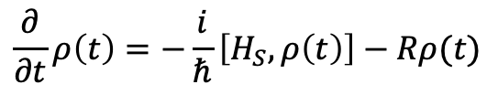
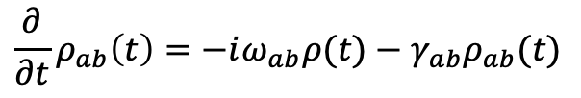
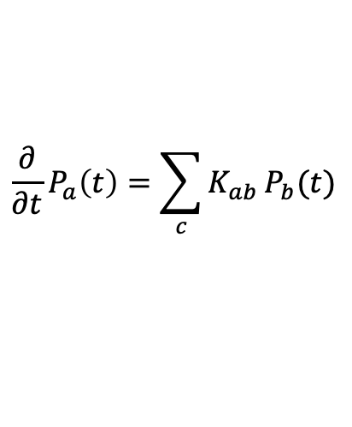
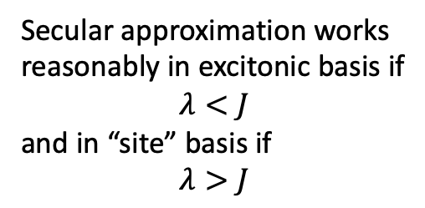
Master Equations for Energy Transfer
$$\frac{∂}{∂t}ρ\left(t\right)=−\frac{i}{ℏ}\left[H_{S},ρ\left(t\right)\right]−Rρ(t)$$
Equations simplify dramatically in
the Secular Approximation:
Populations independent of coherences
Relaxation tensor
In the representation of the proper
eigenstates of H_{S}
Secular approximation works
reasonably in excitonic basis if
$$λ<J$$
and in “site” basis if
$$λ>J$$
$$\frac{∂}{∂t}ρ_{ab}\left(t\right)=−iω_{ab}ρ_{ab}(t)−\sum_{cd}{R_{abcd}}ρ_{cd}(t)$$
$$\frac{∂}{∂t}P_{a}\left(t\right)=\sum_{c}{K_{ab}}P_{b}(t)$$
$$\frac{∂}{∂t}ρ_{ab}\left(t\right)=−iω_{ab}ρ(t)−γ_{ab}ρ_{ab}(t)$$
Population transfer resembles discrete hopping, coherence quickly decays and is irrelevant.

Slide 16




Fundamental Working Principles
In both limits: Energy conservation and resonance
Förster transfer = Fermi golden rule
Redfield transfer = energy conservation
$$λ>J$$
$$λ<J$$
$$ΔE$$
Spectral density
$$C\left(t\right)→C(ω)$$

Slide 17
Quantum Revolution in Photosynthesis:
A failed coup d’état attempt

Slide 18
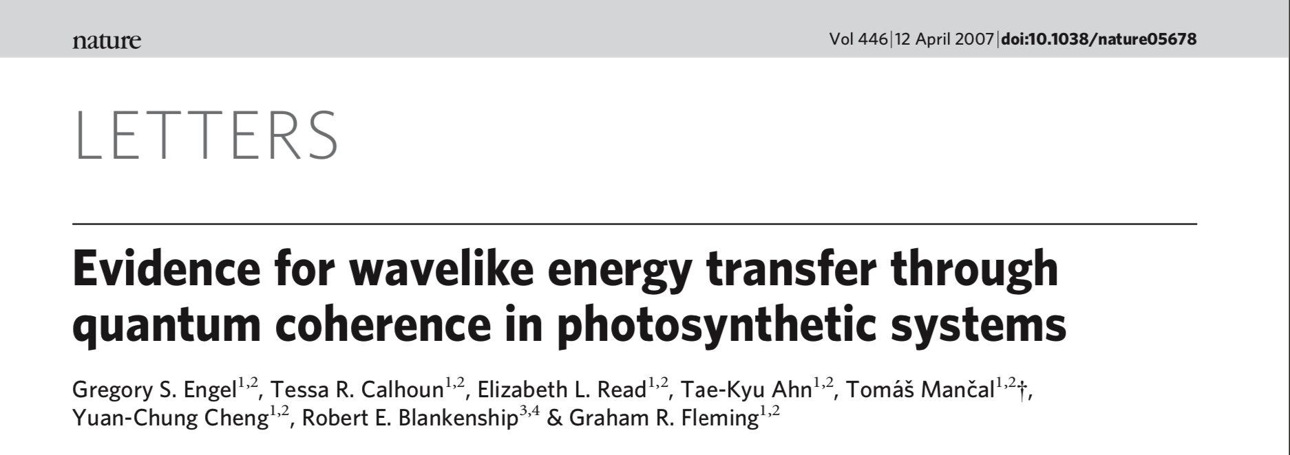
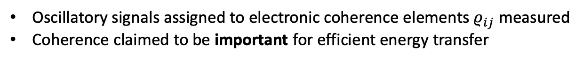
Quantum Coherence Observation of 2007
Oscillatory signals assigned to electronic coherence elements $ρ_{ij}$ measured
Coherence claimed to be important for efficient energy transfer
Speculation!
Necessary condition: secular approximation broken

Slide 19
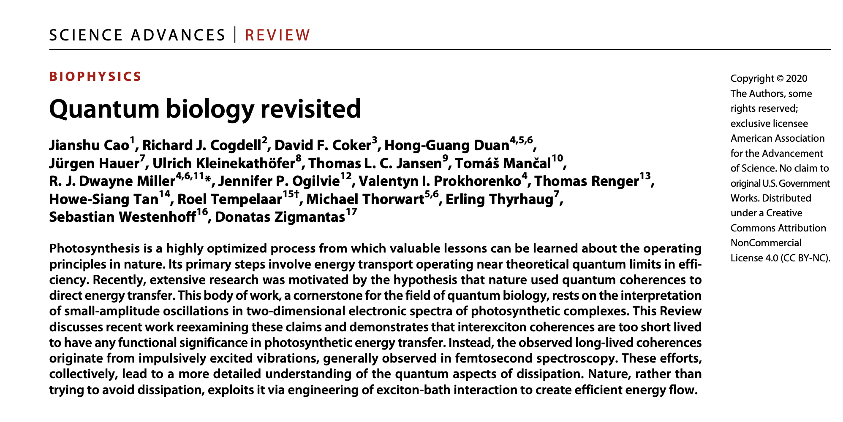
More than a Decade of Disputes
which should end with this!

Slide 20
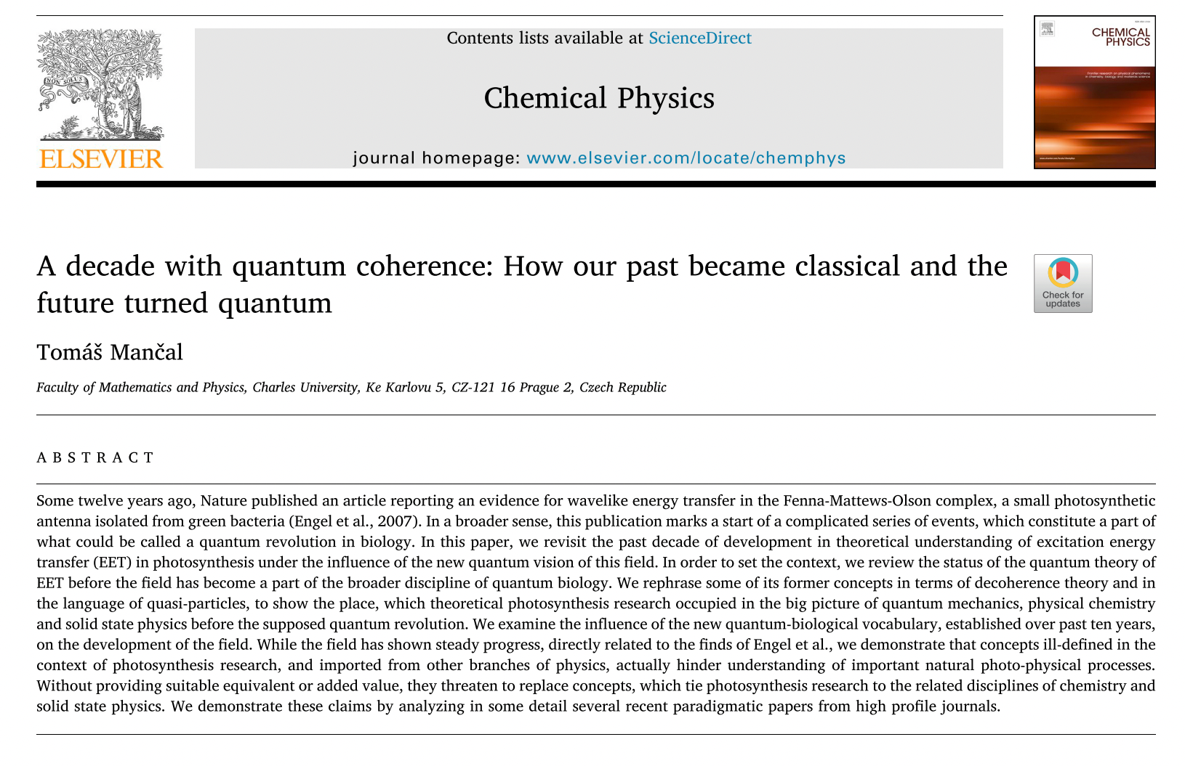
More than a Decade of Disputes
… or with this!

Slide 21
Intramolecular Vibrational Modes of Photosynthetic Pigments: Spectroscopy

Slide 22
Alternative Explanation of Long-lived Oscillations: Intra-molecular Vibrations
Spectral densities full of vibrational contributions
Vibrational modes are omnipresent, but their signatures are “weak”.
Vibrational modes = normal modes, i.e. they have very long coherence lifetime
They interact with electronic degrees of freedom
M. Wendling et al., JPC B 104 (2000) 5825

Slide 23
Vibronic (VIBRational and electrONIC) Coherence
Increase of oscillator strength
is achieved by interaction
with electrons
Interaction is resonant;
there are plenty of modes
available
N. Christensson et al., J. Phys. Chem. B 116 (2012) 7449
A. Chenu et al. Sci. Rep. 3 (2013) 2029
V. Tiwari et al. PNAS 110 (2013) 1203, A. Chin et al. Nature Physics 9 (2013) 113

Slide 24
Excitonic vs. Vibronic Coherence
N. Christensson et al., J. Phys. Chem. B 116 (2012) 7449
Electronic exciton
Vibronic coherence
Explains life-time of dynamic
coherences
but is rather of
the delocalization type
~ 5 % of the SE signal
Vibronic Exciton

Slide 25
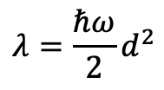
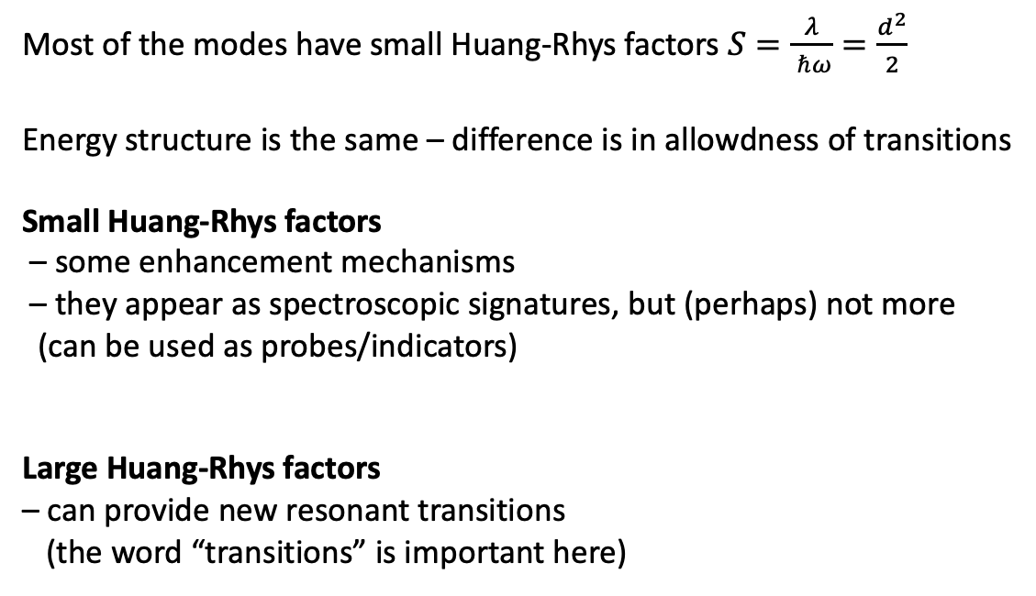


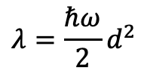
What Nuclear Modes Do?
Most of the modes have small Huang-Rhys factors $S=\frac{λ}{ ℏω}=\frac{d^{2}}{2}$
Energy structure is the same – difference is in allowdness of transitions
Small Huang-Rhys factors
– some enhancement mechanisms
– they appear as spectroscopic signatures, but (perhaps) not more
(can be used as probes/indicators)
Large Huang-Rhys factors
– can provide new resonant transitions
(the word “transitions” is important here)
Electron-“phonon” coupling
$$λ=\frac{ℏω}{2}d^{2}$$
$$λ=\frac{ℏω}{2}d^{2}$$
$$d$$
$$d$$

Slide 26
Intramolecular Vibrational Modes of Photosynthetic Pigments: Energy Transfer

Slide 27
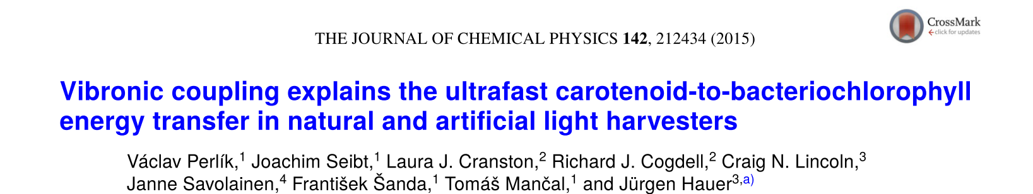
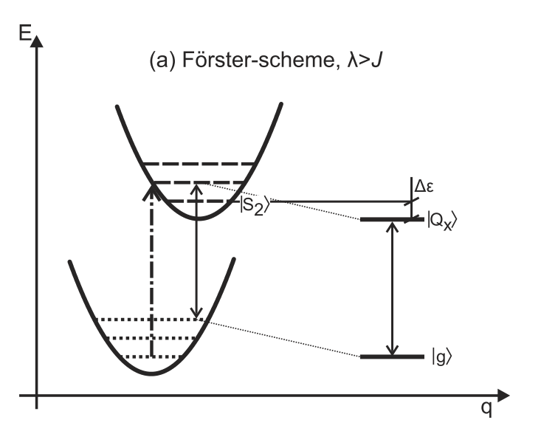
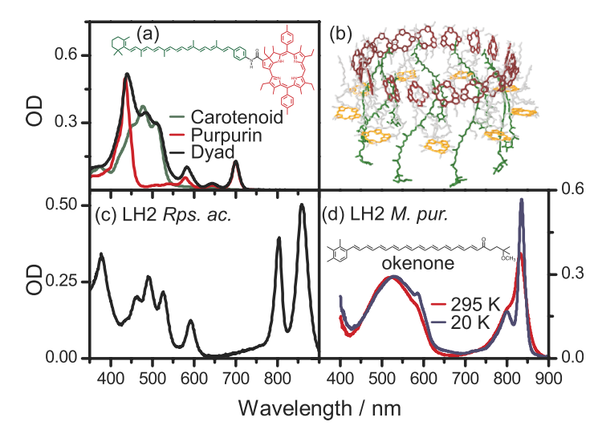
Energy Transfer Across Large Energy Gaps

Slide 28
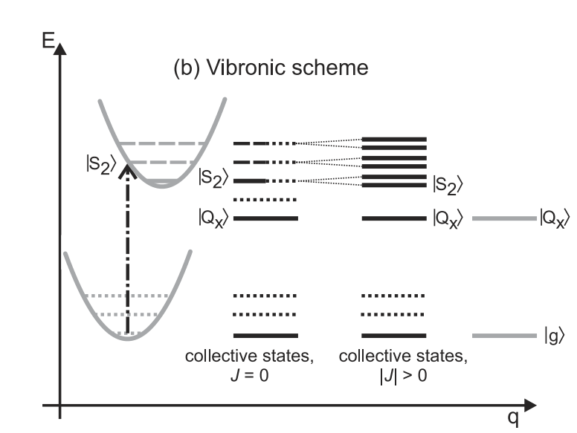
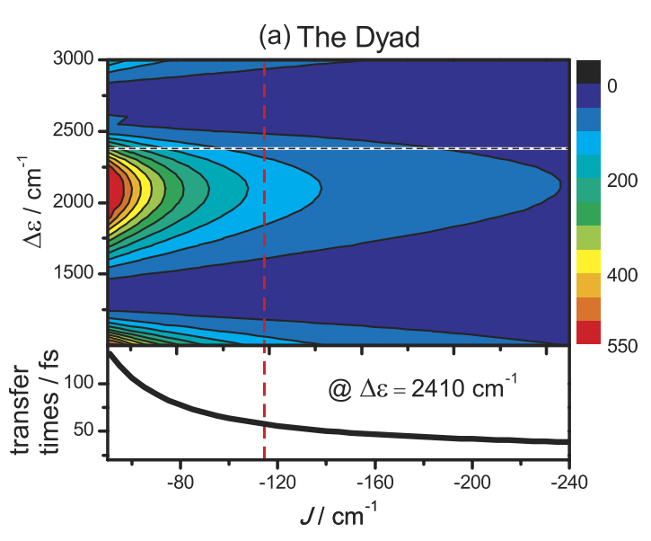
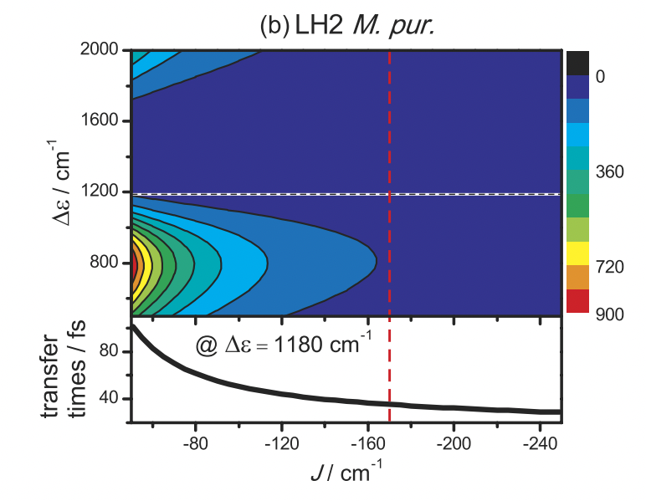
Energy Transfer Across Large Energy Gaps
Perlik

Slide 29
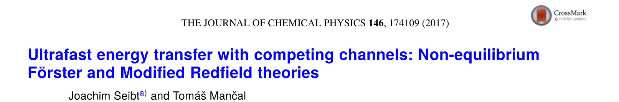
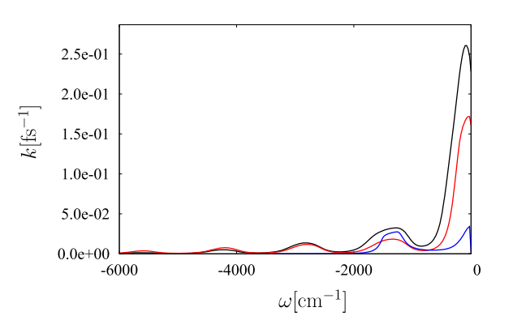
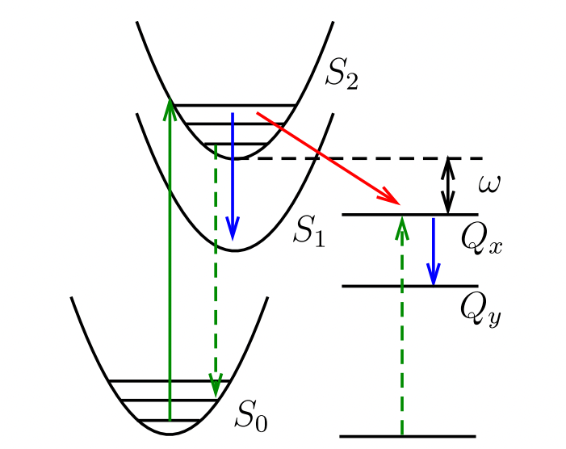
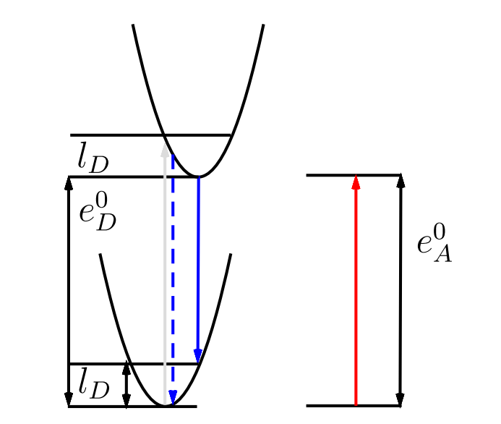
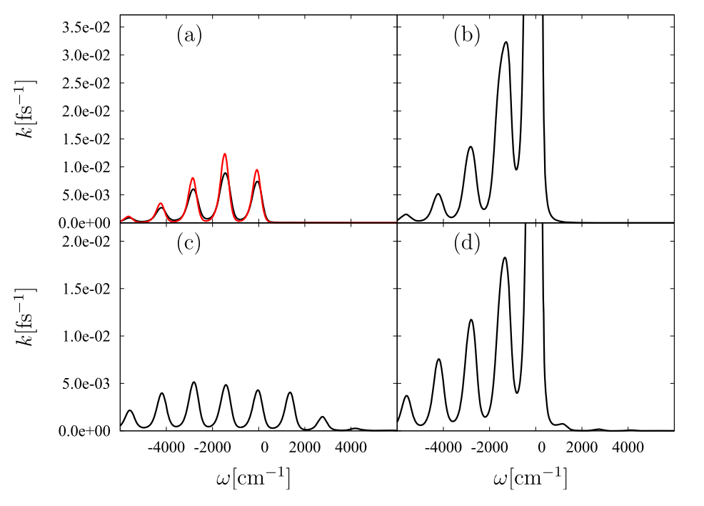
Is Vibronic Delocalization at Play Here?
Modified Redfield vs. Redfield
Stripped picture
Car – BChl energy transfer
Modified Redfield
Förster
nonEq.
Modified Redfield
nonEq. Förster

Slide 30
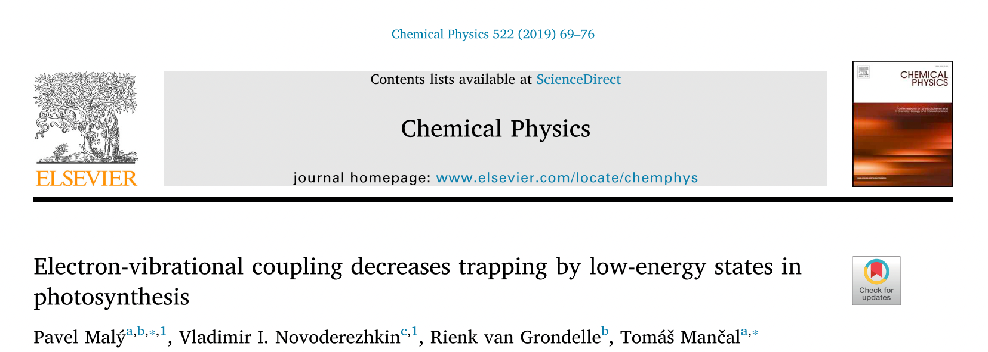
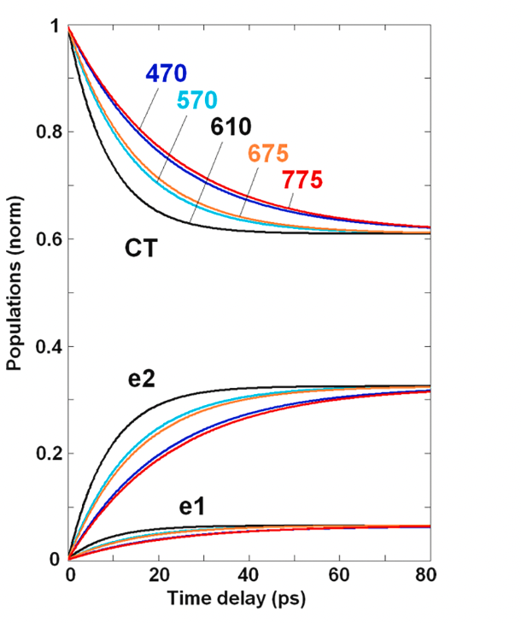
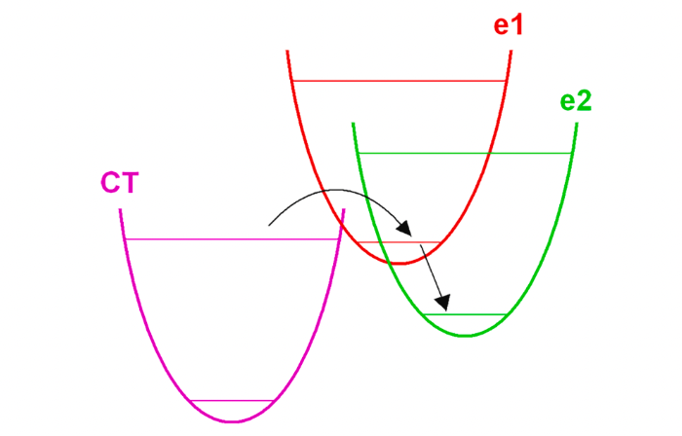
Solution to the Biggest Mystery of Photosynthesis?
Malý
Excitation detrapping

Slide 31
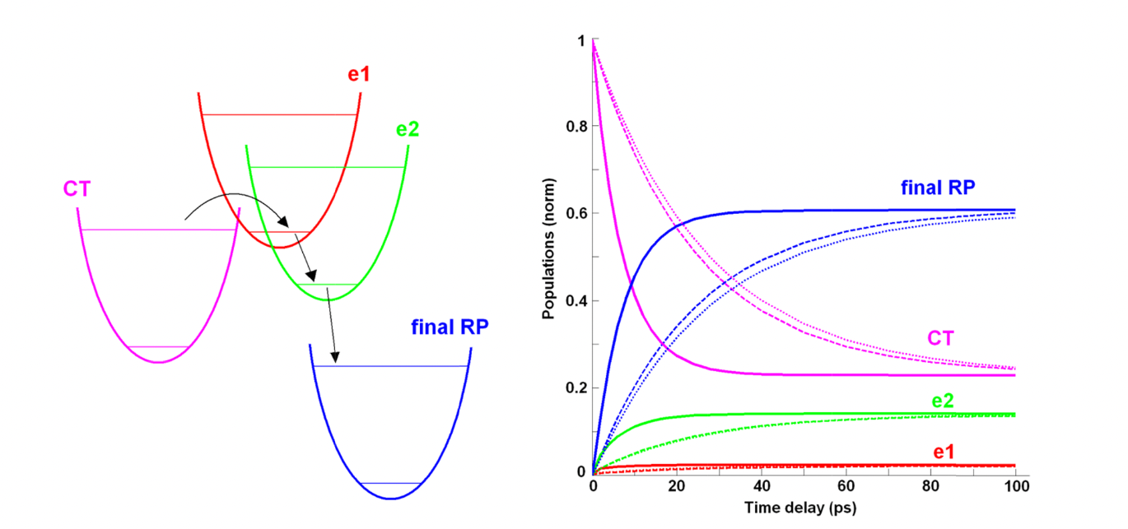
Detrapping towards Lower Lying State

Slide 32
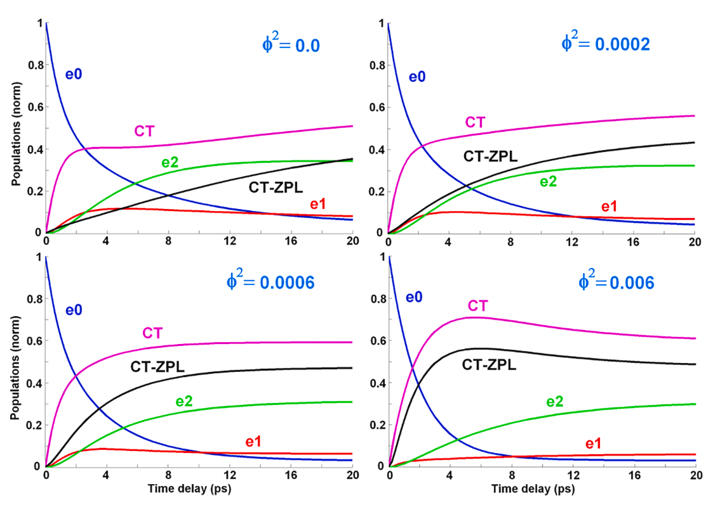
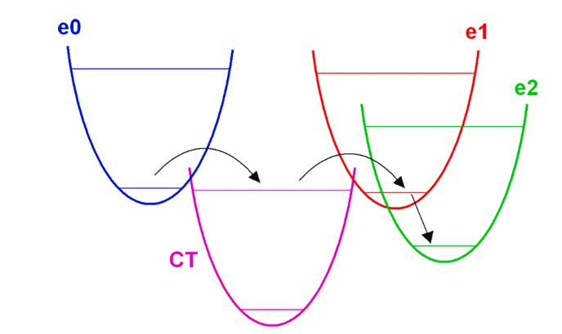
Crossing a Low-Lying State
Malý

Slide 33
Intramolecular Vibrational Modes of Photosynthetic Pigments:
Spectroscopy Meets Energy Transfer

Slide 34
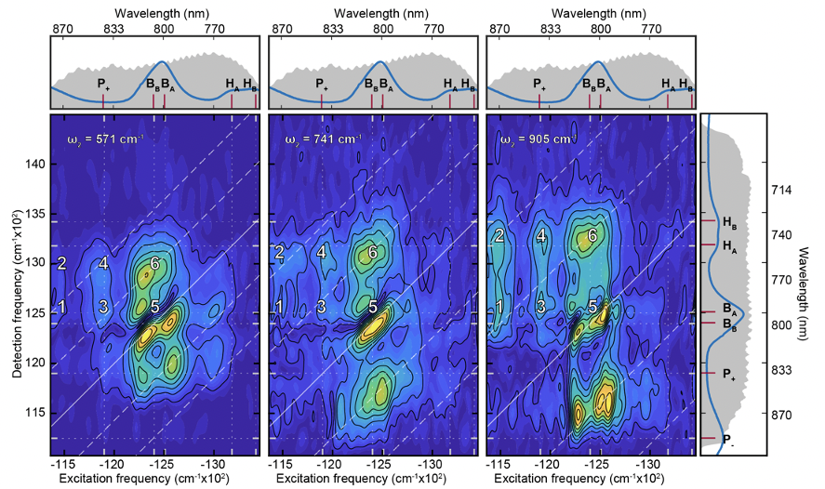
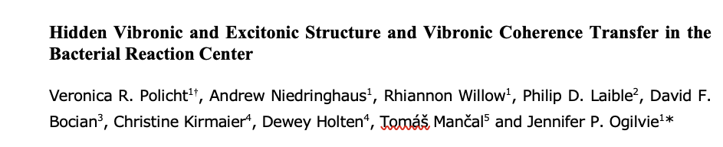
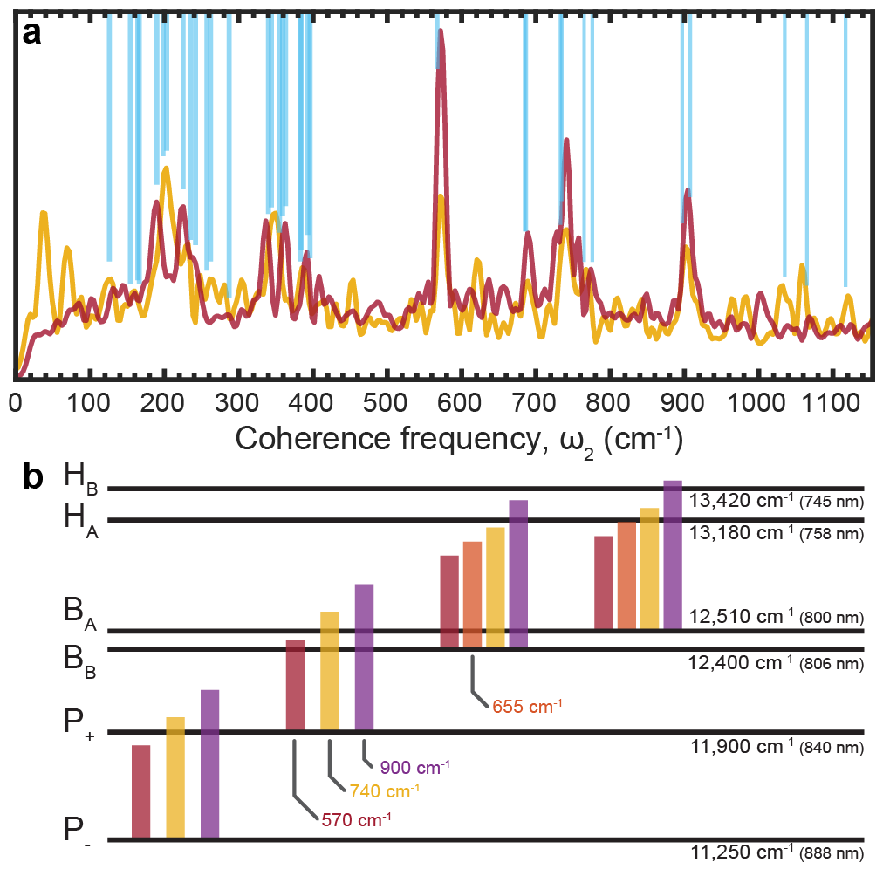
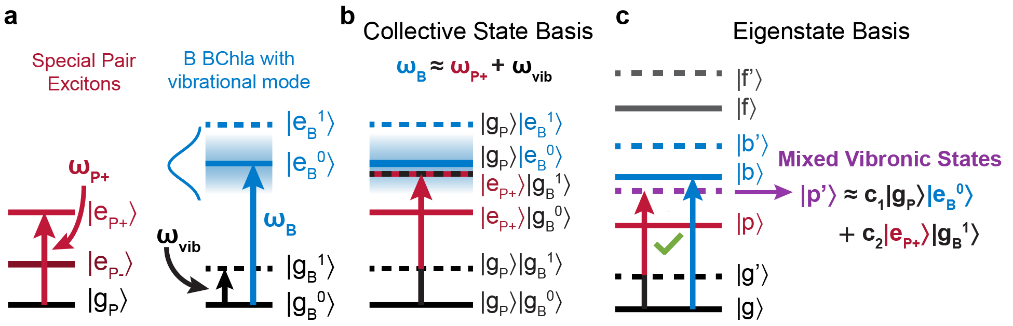

The Magic of Weak Vibronic Delocalization
$ω_{2}$-maps
Vibrational modes in bacterial RC

Slide 35
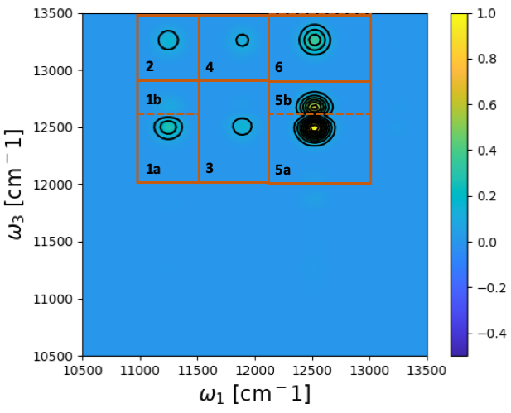
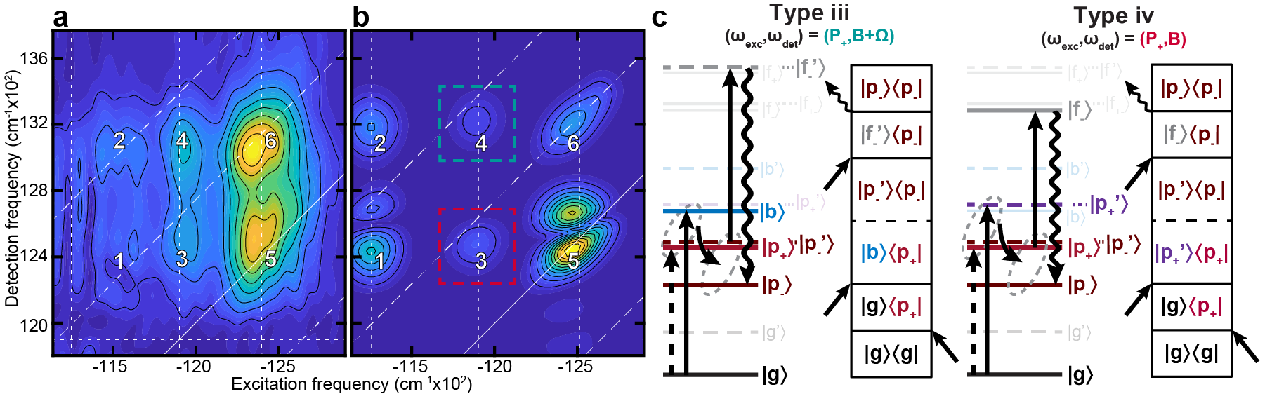
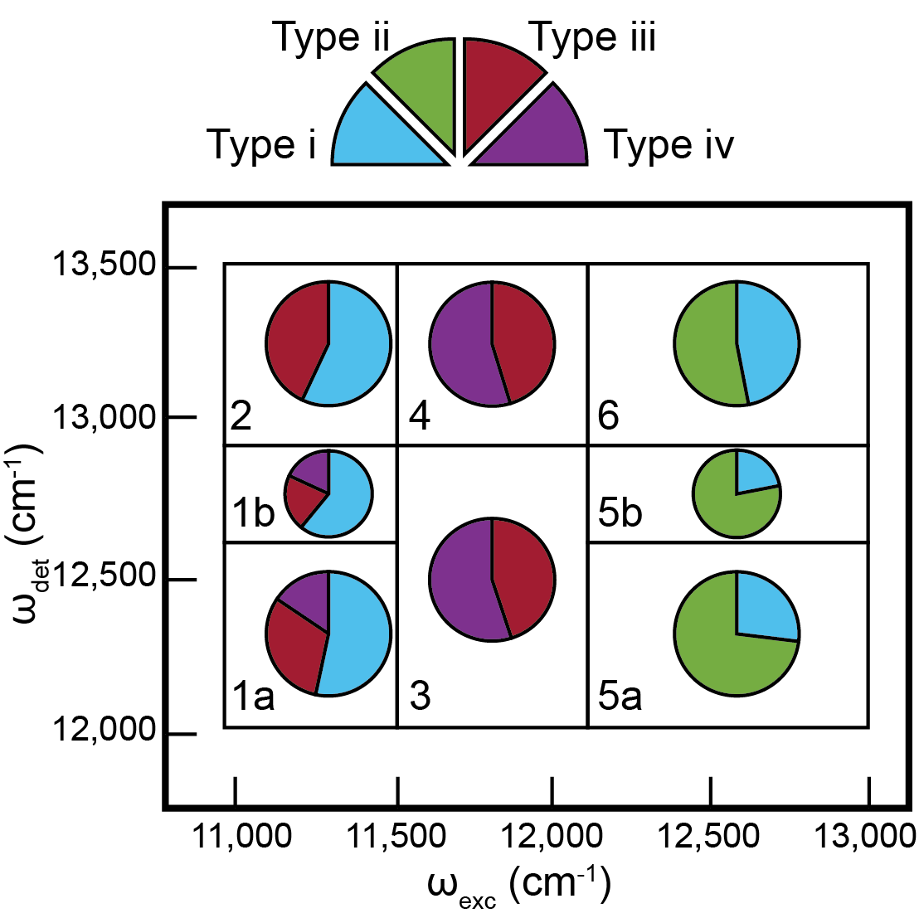
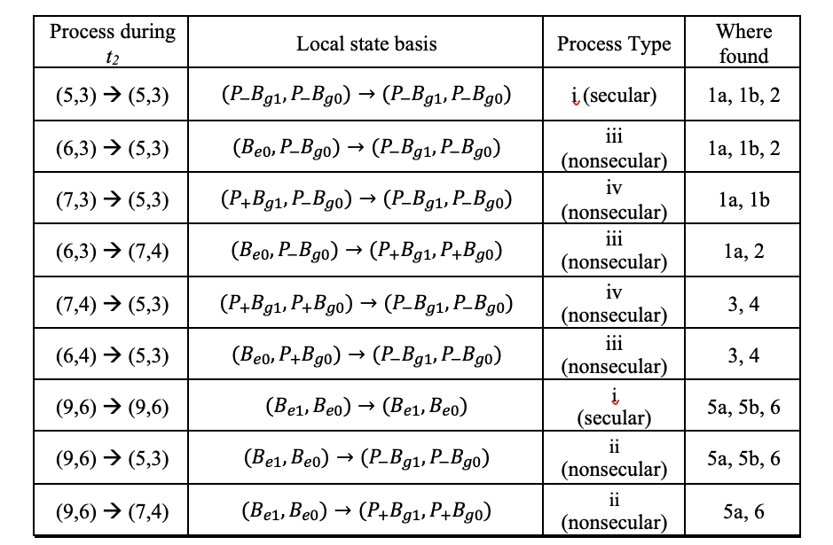
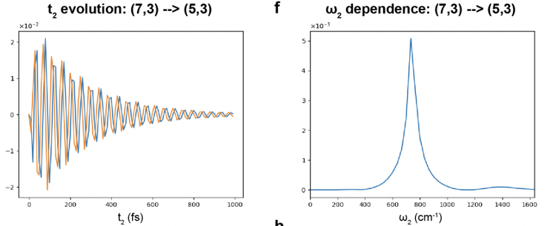
The Magic of Weak Vibronic Delocalization

Slide 36
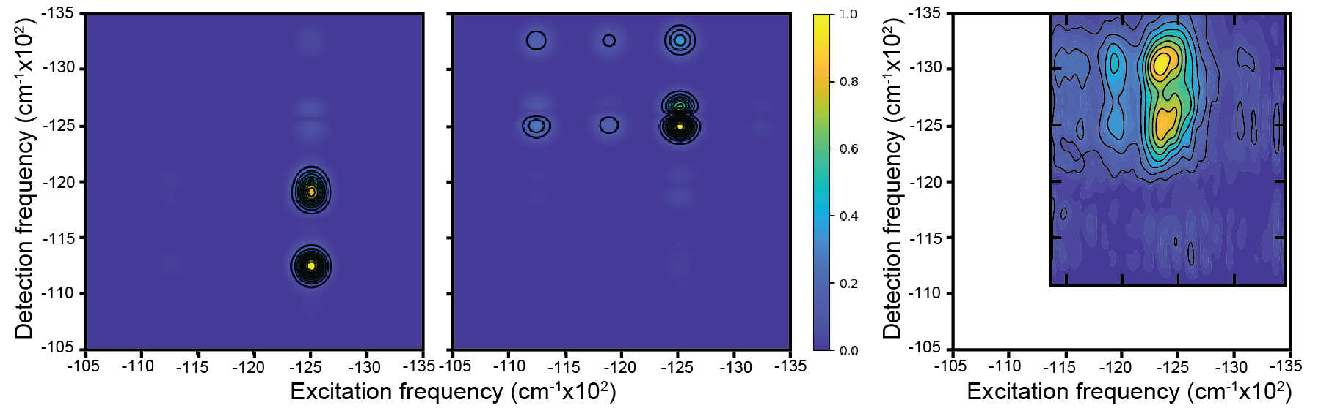
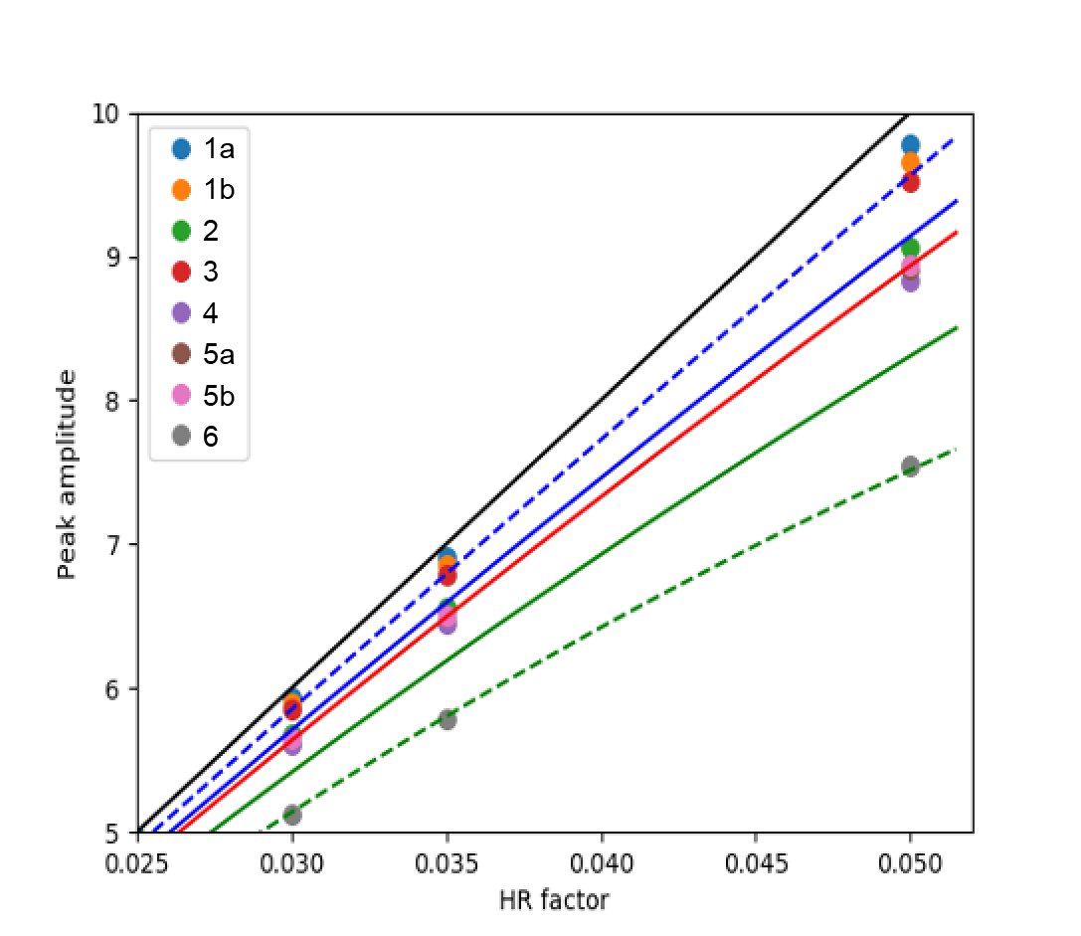
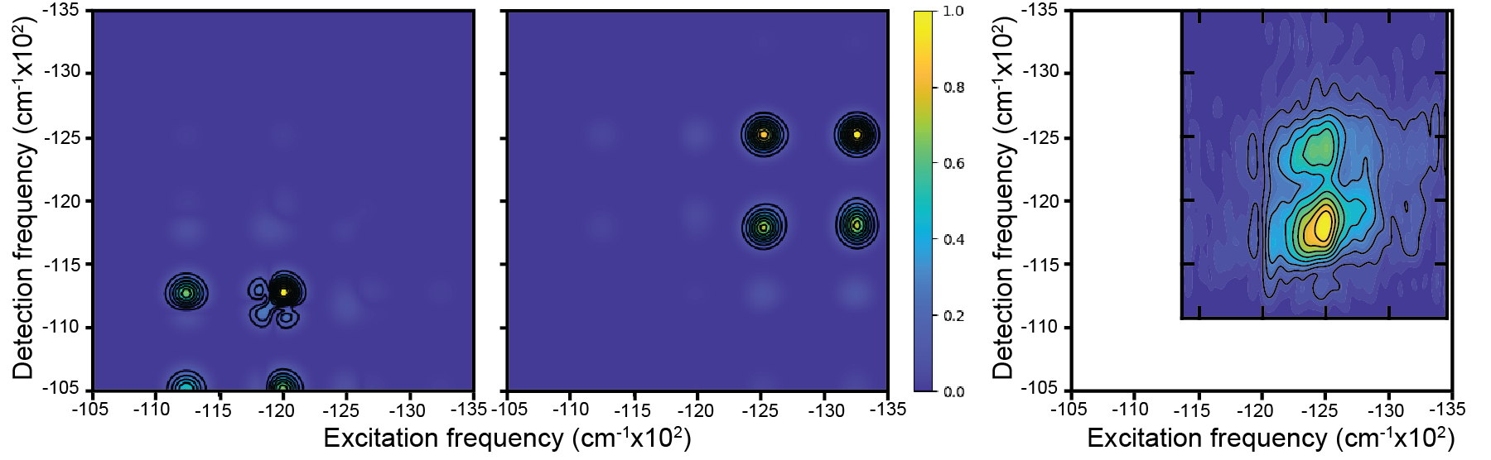
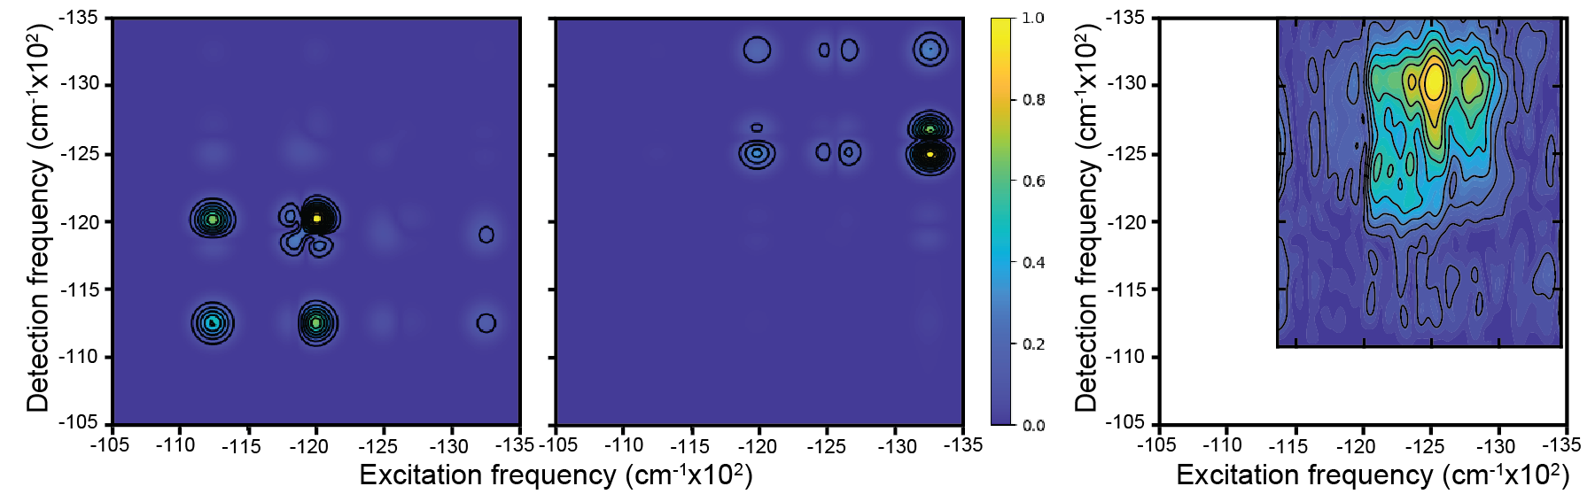

Vibrational Features as Probes for Electronic Structure
Rephasing
positive frequency
Peak amplitudes depend very weakly
on the HR factors
Rephasing
negative frequency
Non-Rephasing
positive frequency
Non-Rephasing
negative frequency
Possibly indicative of structure

Slide 37
Conclusions
Energy transfer and spectroscopic features rely on resonance between transitions
Intramolecular vibrational modes provide additional resonances to fill energy gaps
  support fast energy transfer across large energy gaps
  enable detrapping, trap crossing and similar phenomena
Even outside of exact resonance, (measurable) vibronic delocalization takes place
Vibrational features in 2D spectra highlight unusual transitions allowed by weak vibronic delocalization
How strong electron-phonon coupling needs to be remains to be seen

Slide 38



Acknowledgements
Puebla, Mexico, 2019
The week before Dia de los muertos
Research group
Postdocs (all gone by the end of 2020):
Kieran Fox
Veljko Jankovič
Sue Ann Oh
PhD and Postdoc positions open from 2022
Funding from Czech Science Foundation (GACR)
Neuron fund – private fund for support of basic science

Slide 39
Thank you for your attention!

