Slide 1

Quantum Coherence in Biology
January 19th, 2021
Fyzikální ústav AV
Tomáš Mančal
Faculty of Mathematics and Physics
Charles University

Slide 2
Outline
Energy transfer in photosynthetic antenna – coherent and incoherent transfer of molecular excitons
Sketch of the theory of energy transfer with Frenkel exciton model
Coherence in spectroscopic experiments and the theory
Coherence as a non-trivial quantum effect? Quantum entanglement
Spectroscopic signals of vibrational origin
T. Mančal, A decade with quantum coherence, Chem. Phys. 532 (2020) 110663
Cao et al., Quantum Biology Revisited, Sci. Adv. 6 (2020) eaaz4888 (18 authors)

Slide 3
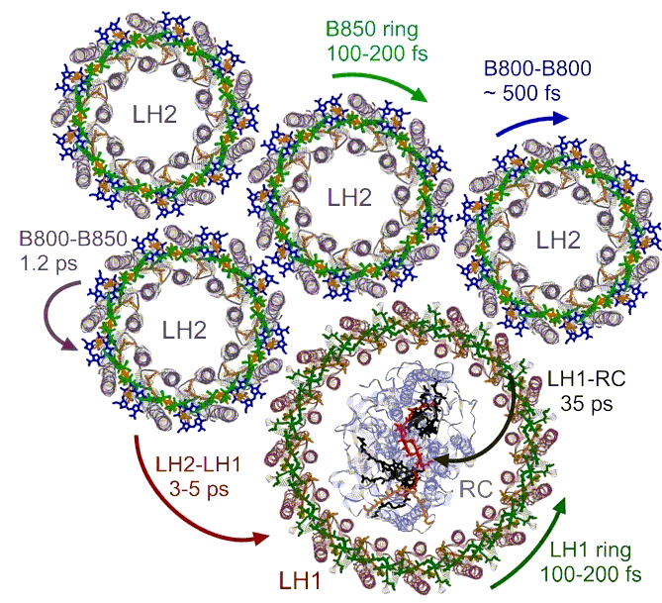
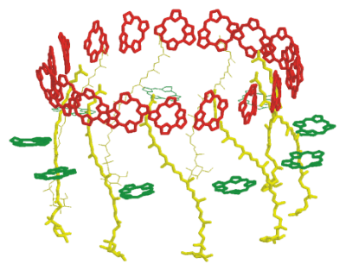
Background and Context
Photosynthetic antennae – e.g. LH1/RC, LH2

Slide 4
Background and Context
Simplification into exciton transfer problem
How it this physics?

Slide 5
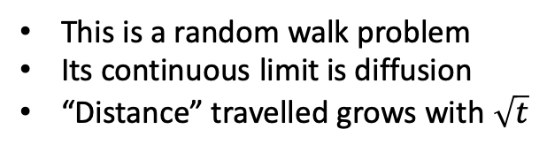
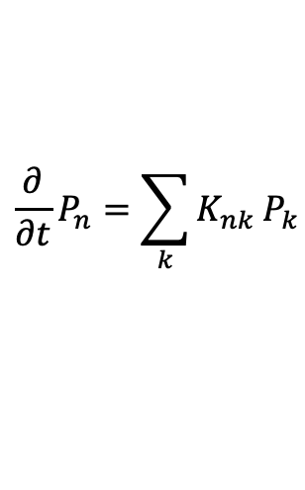
Background and Context
Naïve formulation of the problem
Sites connected by energy transfer rates
K₃₁
This is a random walk problem
Its continuous limit is diffusion
“Distance” travelled grows with $\sqrt{t}$
6
$$\frac{∂}{∂t}P_{n}=\sum_{k}{K_{nk}}P_{k}$$
K₅₃
1
3
5
2
4
Where does this apply?
Between antennae complexes
Between individual weakly coupled molecules

Slide 6
Background and Context
Energy transfer between weakly coupled pigments
Förster resonance energy transfer: second order perturbation theory
Fermi Golden rule
Donor
Acceptor
The essence of photo-synthetic
energy transfer!

Slide 7
Background and Context
Energy transfer between two antennae
First complication
Simple Förster resonance energy transfer (FRET)
does not work!
FRET requires overlap of donor fluorescence and acceptor
absorption
The bands are too far apart
But energy transfer occurs – the solution is the collective character of antenna states

Slide 8
Background and Context
Collective antenna states
Donor
Acceptor
Strong coupling
2 x excited
1 x excited
2 x resonance coupling
0 x excited

Slide 9
Background and Context
Usual antennae – collection of delocalized and localized states
Strong coupling
Localized states -
individual bacteriochlorophylls
Delocalized
states
Weak coupling
Weak coupling

Slide 10
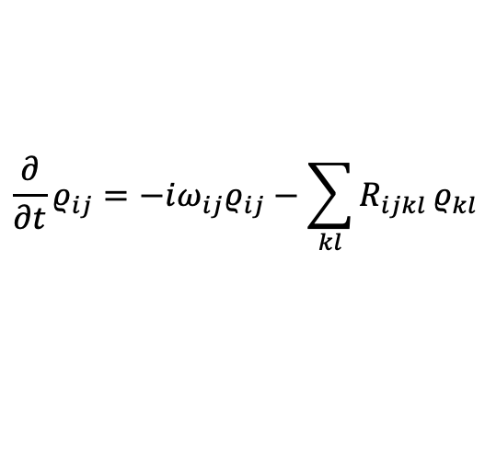
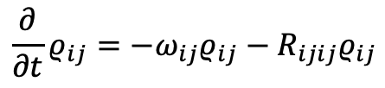
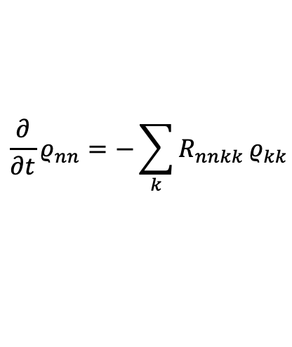
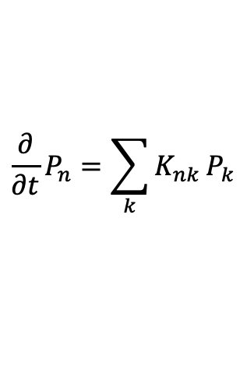


Background and Context
Energy transfer in strongly coupled aggregate
Strong coupling
Yes, if we think in terms of aggregate/antenna
eigenstates:
$$\frac{∂}{∂t}ρ_{ij}=−iω_{ij}ρ_{ij}−\sum_{kl}{R_{ijkl}}ρ_{kl}$$
Energy transfer does not occur in space
Spatially distinct states cannot be excited
by light
Secular approximation
$$\frac{∂}{∂t}ρ_{nn}=−\sum_{k}{R_{nnkk}}ρ_{kk}$$
$$\frac{∂}{∂t}ρ_{ij}=−ω_{ij}ρ_{ij}−R_{ijij}ρ_{ij}$$
Does
$$\frac{∂}{∂t}P_{n}=\sum_{k}{K_{nk}}P_{k}$$
make any sense here?
Energy transfer
Dephasing of coherence
$$K_{nk}=−R_{nnkk}$$
$$γ_{ij}=R_{ijij}$$

Slide 11
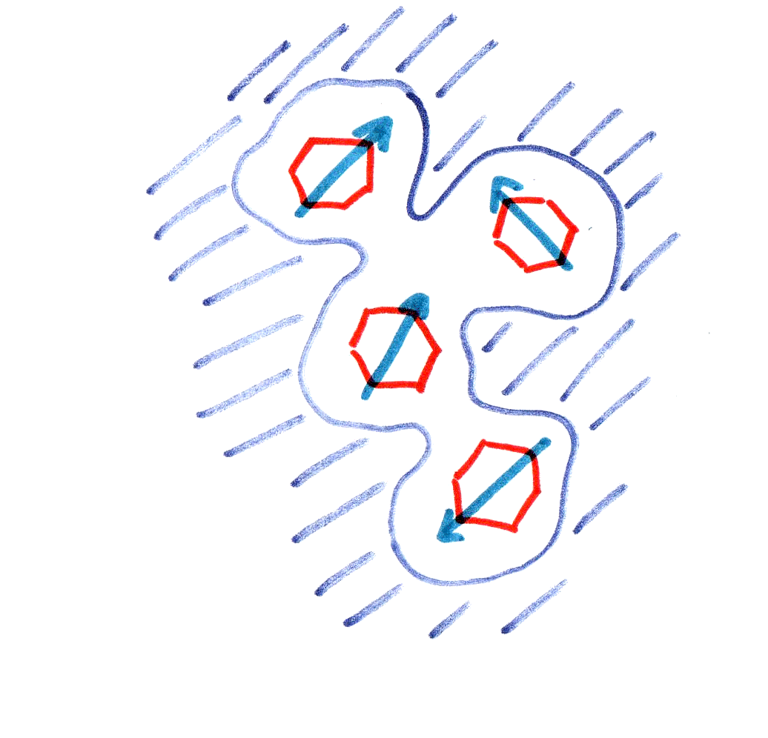
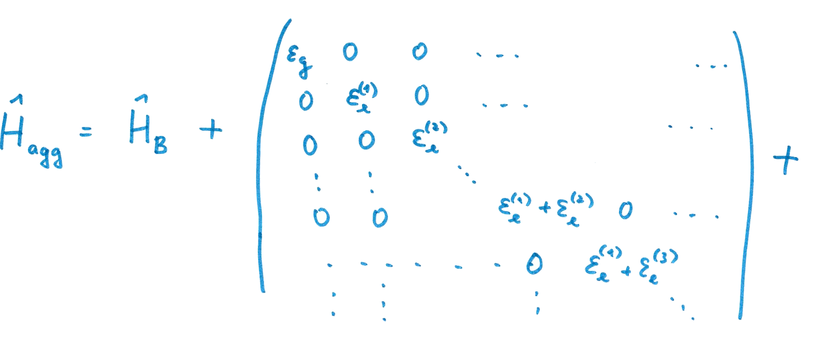
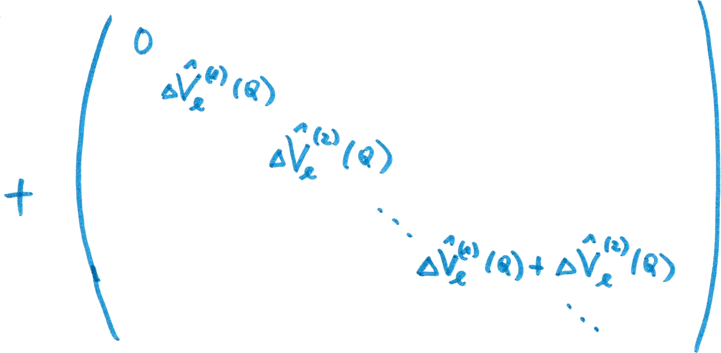
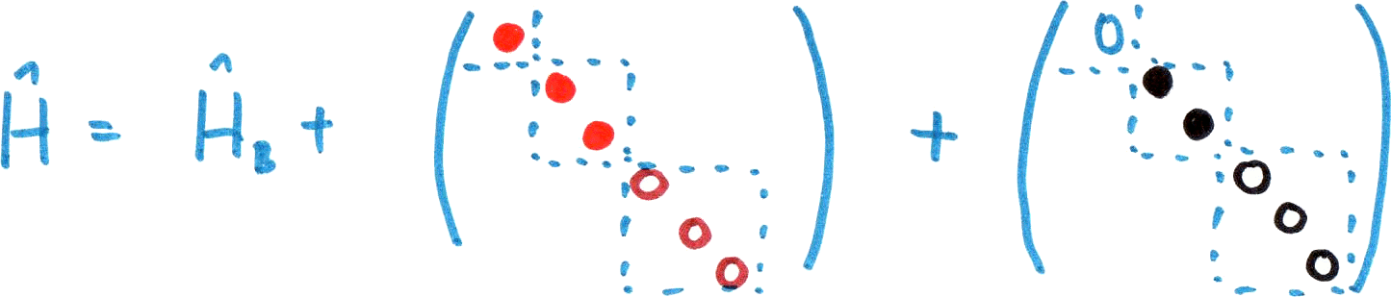
Structure of the Hamiltonian
(Why Energy Relaxes?)
Antenna molecules interacting with an environment
Structure of the Hamiltonian

Slide 12
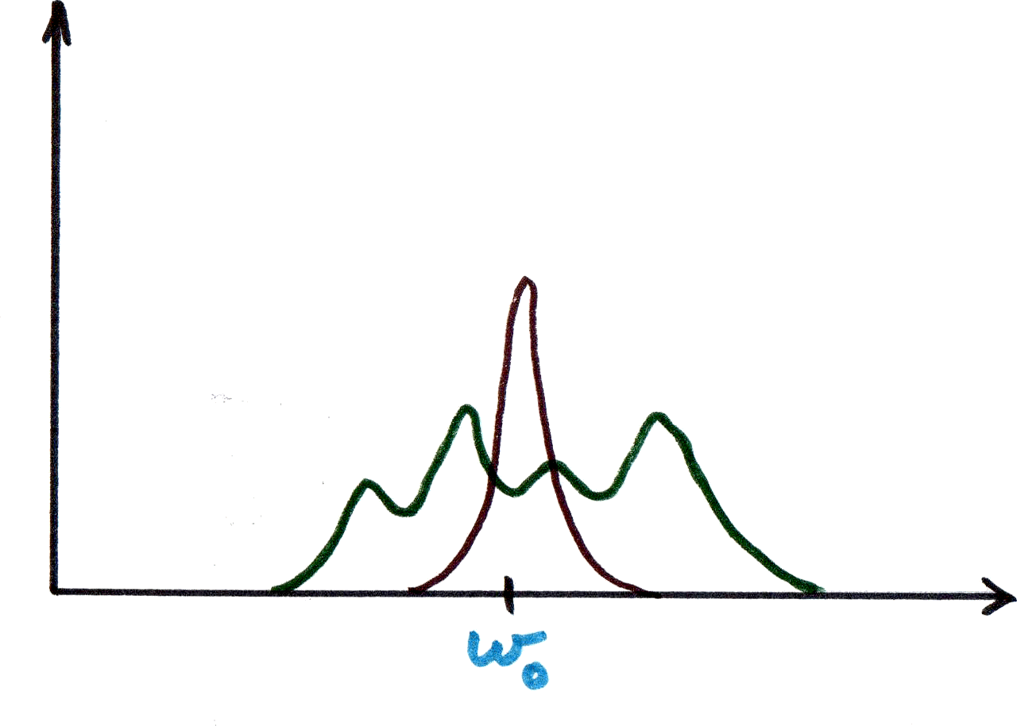
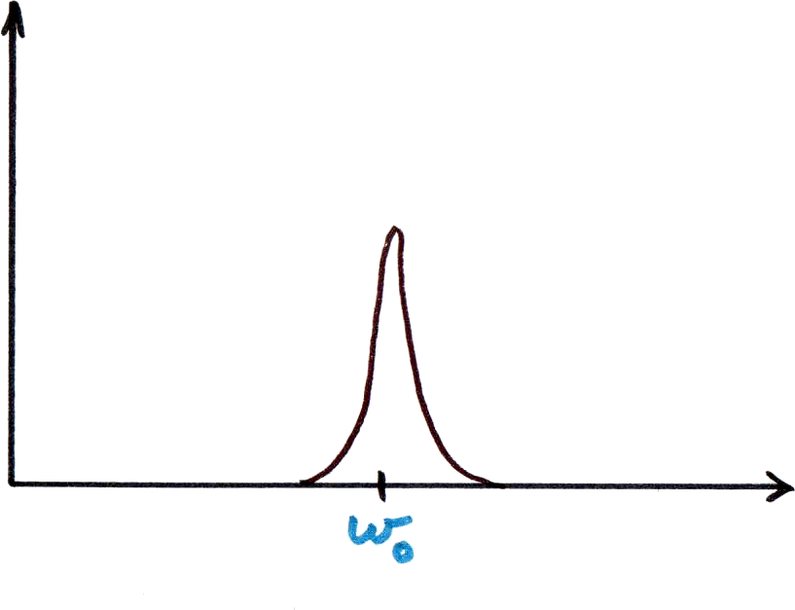
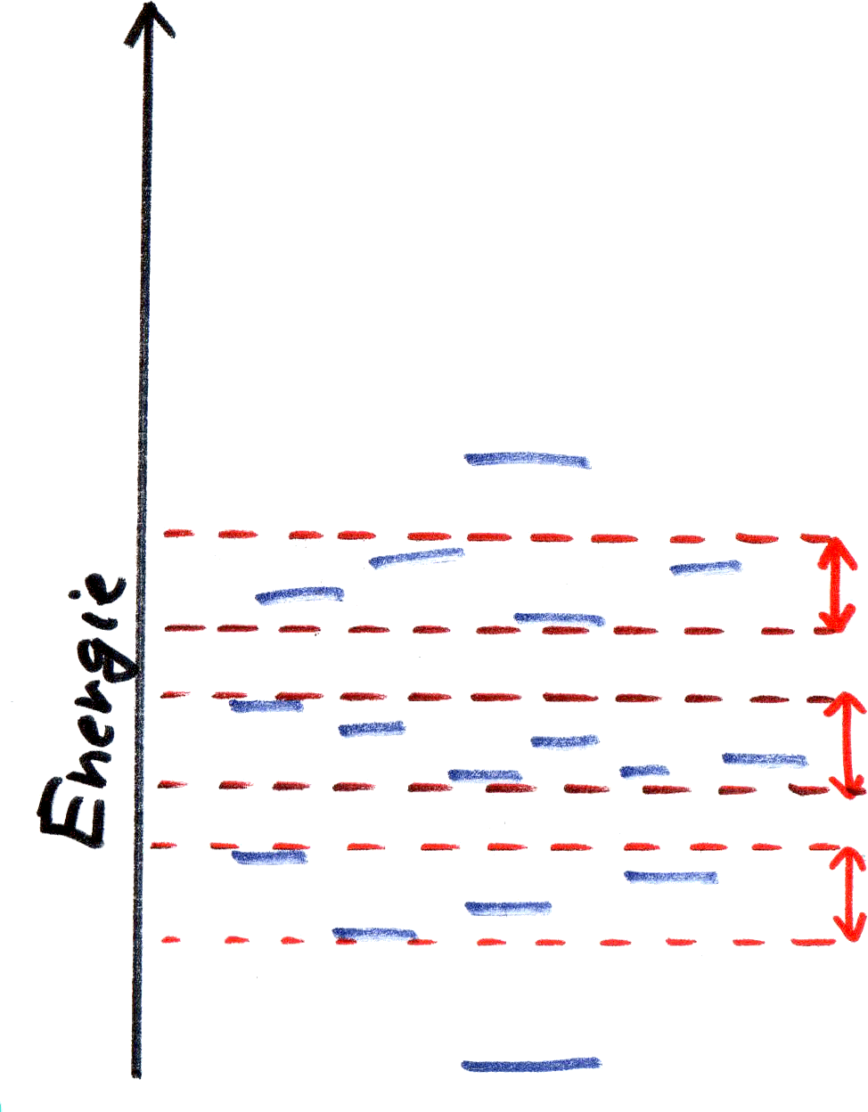
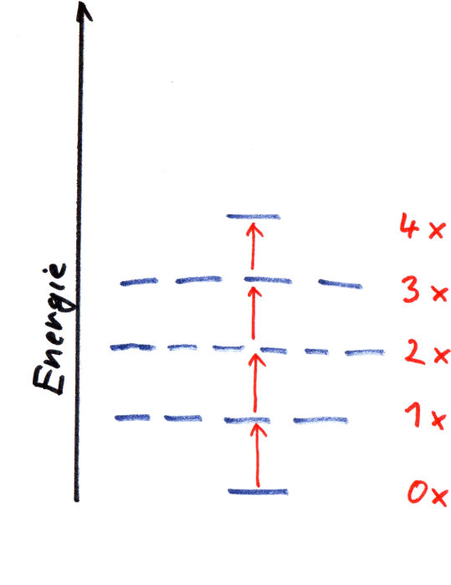
Introducing Intermolecular Interaction
N identical molecules =
N identical spectra
Homogeneous width due
to ∆V(Q)
We add interaction
between chromophores
Degeneracy among excited states is lifted

Slide 13
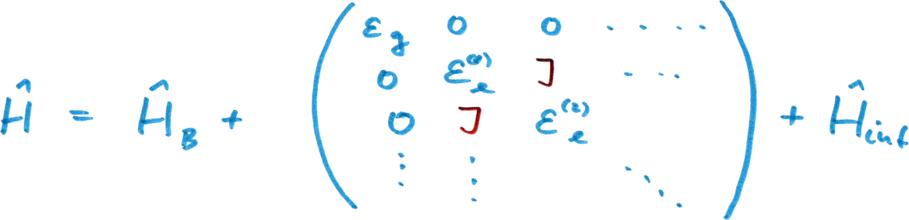
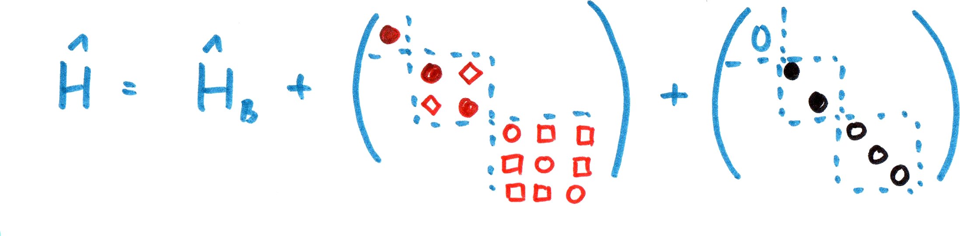
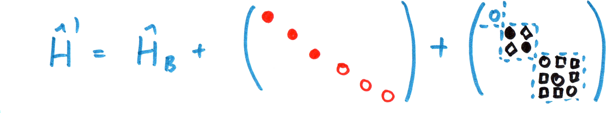
Back to Hamiltonian
Hamiltonian is no more diagonal – new eigenstates and eigenenergies
Non-diagonal terms
in the system-bath interaction

Slide 14
System Bath Interaction
Protein bath
Complete Hamiltonian
Usual splitting

Slide 15
System Bath Interaction:
Problem of Basis
Site basis
Exciton basis
2 approaches, 2 limits
Weak System-bath coupling
Relaxation between eigenstates of the Hamiltonian H_{el} (excitonic or delocalizeb basis)
Energy gap correlation function

Slide 16
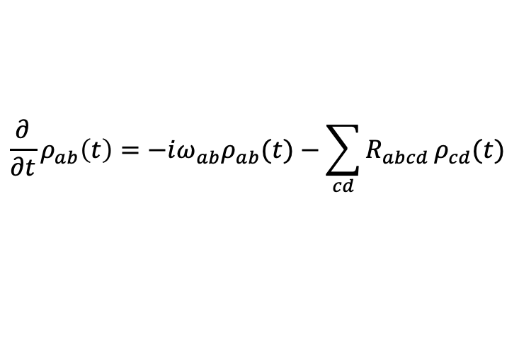
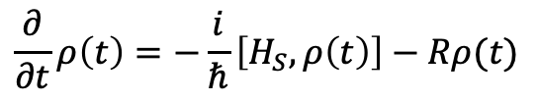
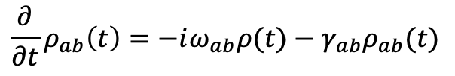
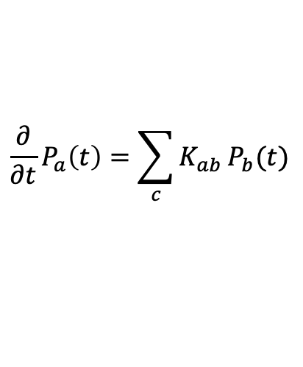
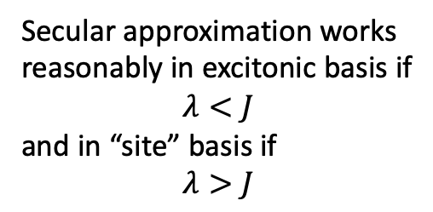
Master Equations for Energy Transfer
$$\frac{∂}{∂t}ρ\left(t\right)=−\frac{i}{ℏ}\left[H_{S},ρ\left(t\right)\right]−Rρ(t)$$
Equations simplify dramatically in
the so-called Secular Approximation:
Populations independent of coherences
Relaxation tensor
In the representation of the proper
eigenstates of H_{S}
Secular approximation works
reasonably in excitonic basis if
$$λ<J$$
and in “site” basis if
$$λ>J$$
$$\frac{∂}{∂t}ρ_{ab}\left(t\right)=−iω_{ab}ρ_{ab}(t)−\sum_{cd}{R_{abcd}}ρ_{cd}(t)$$
$$\frac{∂}{∂t}P_{a}\left(t\right)=\sum_{c}{K_{ab}}P_{b}(t)$$
$$\frac{∂}{∂t}ρ_{ab}\left(t\right)=−iω_{ab}ρ(t)−γ_{ab}ρ_{ab}(t)$$
Population transfer resembles discrete hopping, coherence quickly decays and is irrelevant.

Slide 17
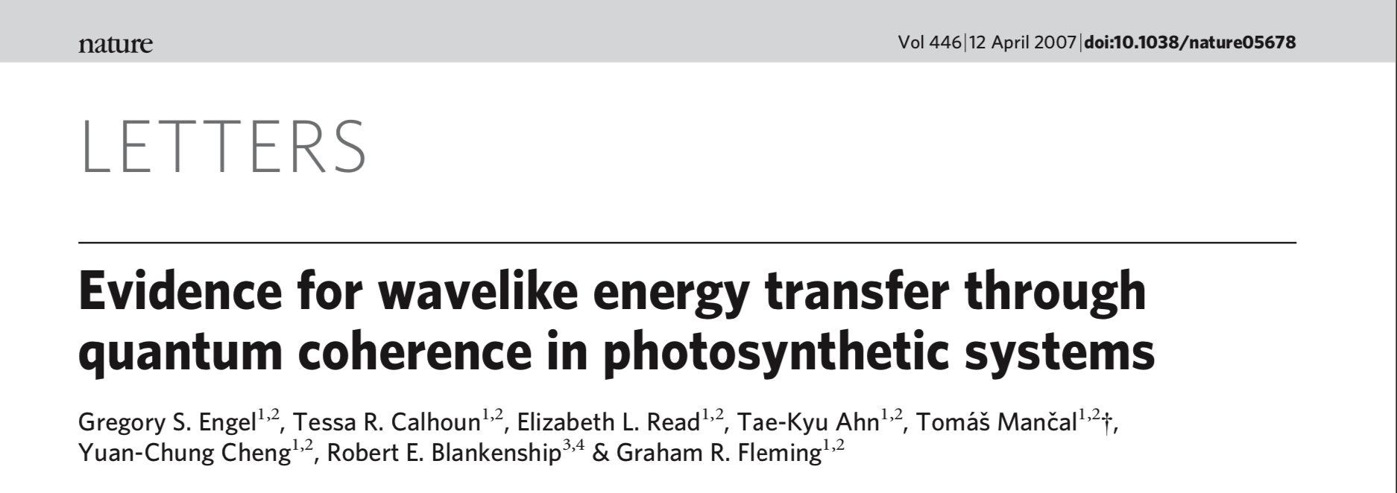

“Quantum Revolution” of 2007
Oscillatory signals assigned to electronic coherence elements $ρ_{ij}$ measured
Coherence claimed to be important for efficient energy transfer
Speculation!
Necessary condition: secular approximation broken

Slide 18
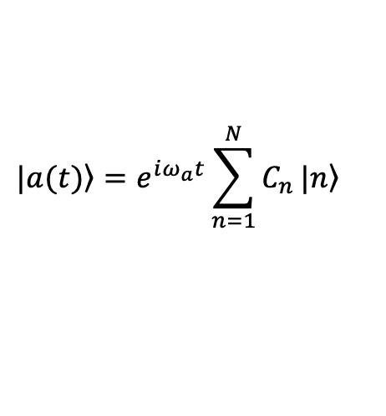
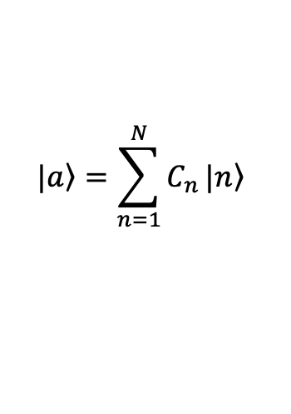
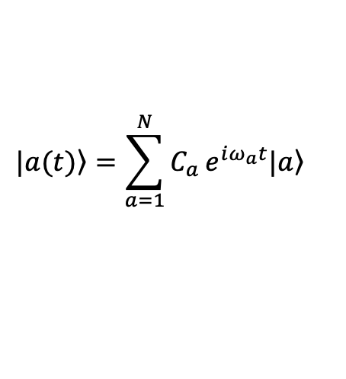
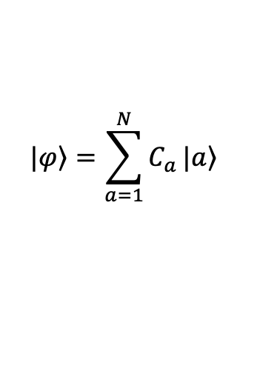
Confusion about “Coherences”
Two meanings of electronic quantum coherences
Visible in 2D spectroscopy
as crosspeaks at t₂ = 0
1. Quantum coherence established by strong Coulomb coupling
Stable under weak
system-bath interaction
Well-known functional role
in establishing ultrafast
excitation energy transfer
$$|\left.a\right\rangle =\sum_{n=1}^{N}{C_{n}}|\left.n\right\rangle$$
$$|\left.a(t)\right\rangle =e^{iω_{a}t}\sum_{n=1}^{N}{C_{n}}|\left.n\right\rangle$$
Single frequency
2. Dynamic quantum coherence established by excitation
$$|\left.φ\right\rangle =\sum_{a=1}^{N}{C_{a}}|\left.a\right\rangle$$
$$|\left.a(t)\right\rangle =\sum_{a=1}^{N}{C_{a}}e^{iω_{a}t}|\left.a\right\rangle$$
No known/verified functional
role in photosynthesis
Multiple frequencies
Prone to decoherence under weak
system-bath interaction
Visible in 2D spectroscopy
as oscillatory dynamics

Slide 19
Does “coherent transfer” of excitons make sense?
What is an exciton?
A quasiparticle, i.e. an entity, which in a first approximation, does not interact with the rest of the system.
Exciton is free up interactions, which can be taken into account by perturbation theory.
Important consequences
Equilibrium state of a system of exciton states is canonical

Slide 20
Coherent Energy Transfer
Energy
trap
Energy

Slide 21
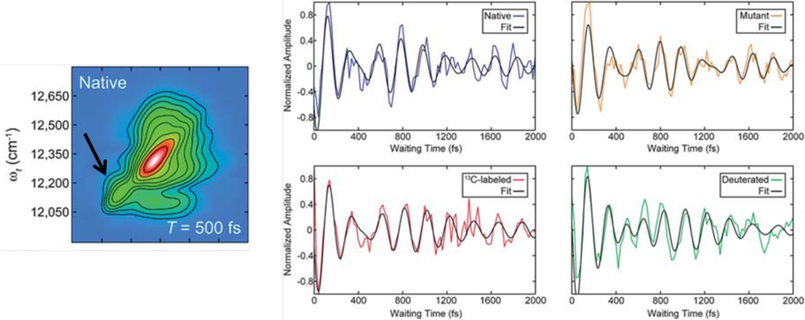
Oscillations in FMO Protein
Theoretical prediction: Pisliakov, Mančal, Fleming, J. Chem. Phys. (2006) (100 – 500 fs)
Original observation: Engel et al. Nature (2007) (lifetime > 1 ps )
Hayes et al., Faraday Discuss. 150 (2011) 459

Slide 22
Oscillations are Everywhere
MEH-PPV
LHCII
Calhoun et al., JPCB 113 (2009) 16291
PE545
Collini and Scholes, Science 323 (2009) 369
Collini et al., Nature 463 (2010) 644

Slide 23
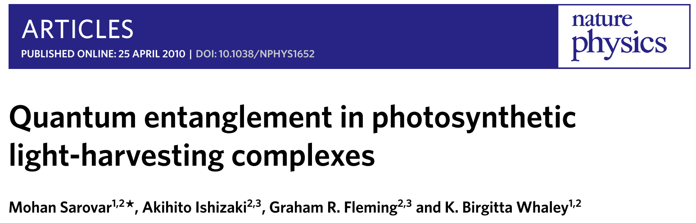
Consequences of 2007 paper
should have been: work on non-secular effects
was:
  claims of newly discovered quantum nature of photosynthesis
  coherent = quantum = non-trivially quantum = entanglement is the cause of all the high efficiency in photosynthesis
  many new works building the theory of energy transfer from scratch (most reinventing the wheel)
Claim: Entanglement exists
between parts of the antenna
Any surprise?
Parts of the antenna are in strong
interaction – trivial formal
entanglement. Could there be no
entanglement?

Slide 24
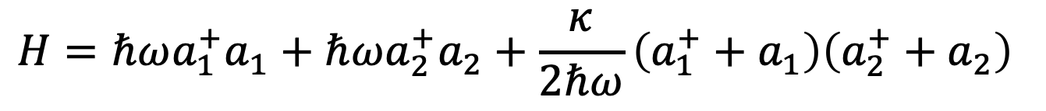
Entangled means Quantum?
Very simple counter-example: quantization of crystal lattice vibrations
Procedure is:
Write down classical Hamiltonian
Diagonalize it (= find normal modes)
Quantize by canonical quantization
Diagonalization BEFORE quantization
The order can be switched (leading to the same result)
$$H=ℏωa_{1}^{+}a_{1}+ℏωa_{2}^{+}a_{2}+\frac{κ}{2ℏω}\left(a_{1}^{+}+a_{1}\right)\left(a_{2}^{+}+a_{2}\right)$$
Eigenenergies:
$$a_{+}≈(a_{1}+a_{2})$$
Crystal phonons are
entangled states of
local nuclear vibrations
$${ℏΩ}_{−}=ℏ\sqrt{ω^{2}−κ}, ℏΩ_{+}=ℏ\sqrt{ω^{2}+κ},$$
$$a_{−}≈(a_{1}−a_{2})$$

Slide 25
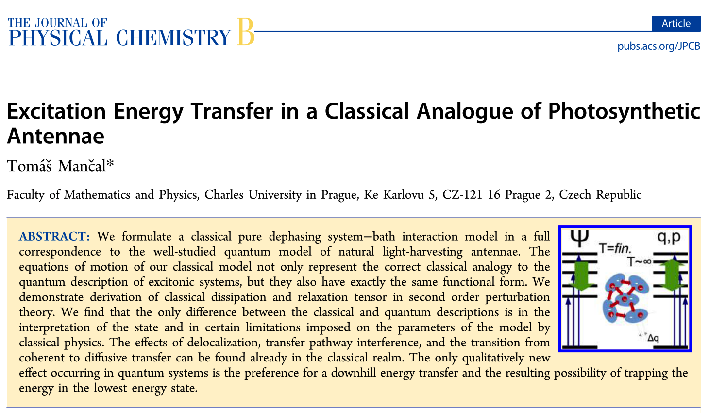
Coherent means Quantum?
Very simple counter-example: coherent light = best quantum representation of classical light
Nobody checked classical models of light-harvesting antenna, before claiming quantum effects.
Important corrective works
  S. Mukamel, J. Chem. Phys. 132 (2010) 241105,
  J. S. Briggs and A. Eisfeld, Phys. Rev. E 83 (2011) 051911
}
Excitonic systems can be mapped a set of classical
oscillators – no non-trivial, let alone quantum, dynamics
This work includes interaction with protein into classical model – also proves equivalence between classical and quantum …
with one important exception! Classical dissipation does not lead to canonical equilibrium.

Slide 26
What is Quantum in Photosynthesis?
Quantum = different from classical
Classical picture of photosynthetic antenna:
T. Mančal, J. Phys. Chem. B 117 (2013) 11282
Lorentz theory of absorption (1910)
Electrically neutral atom (molecule)
Electron is displaced by interaction with light
z
-
-
wave vector
+
+
y
x
displacement
incoming field
polarization

Slide 27
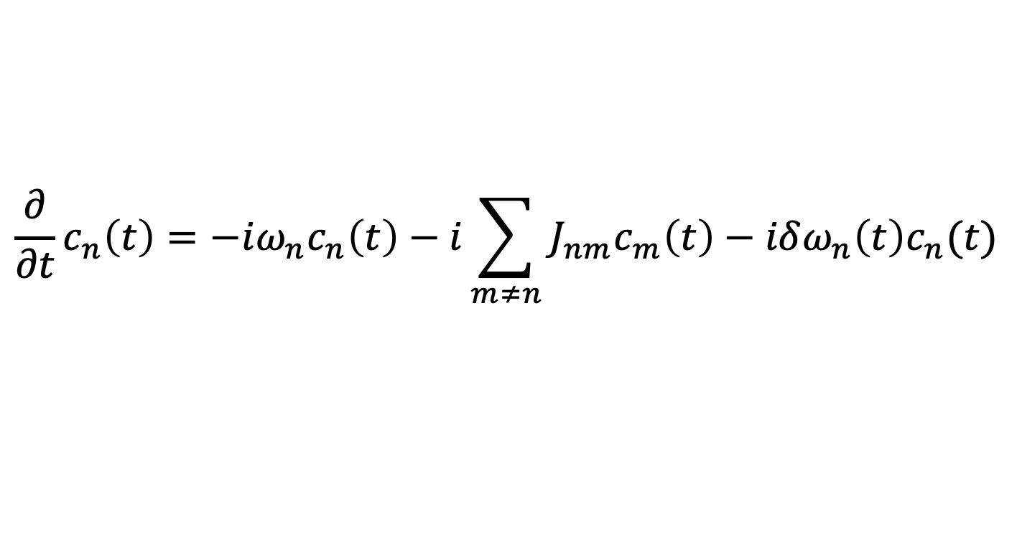

What is Quantum in Photosynthesis?
Classical equations for electronic displacement
Identification of electronic oscillator amplitude with electronic (optical) coherence
Perfect mapping of Schrödinger equation for excitons on a set of oscillators
Pointed out by Mukamel
Studied in detail by Briggs and Eisfeld
Equation of motion for a set of (classical) harmonic oscillators coupled to a reservoir
$$\frac{∂}{∂t}c_{n}\left(t\right)=−iω_{n}c_{n}\left(t\right)−i\sum_{m≠n}{J_{nm}c_{m}\left(t\right)}−iδω_{n}\left(t\right)c_{n}(t)$$
Amplitude of n-th oscillator
Modulation of frequency by bath
Coupling between oscillators
$$q_{n}\sim { c}_{n}+c_{n}^{∗}$$

Slide 28

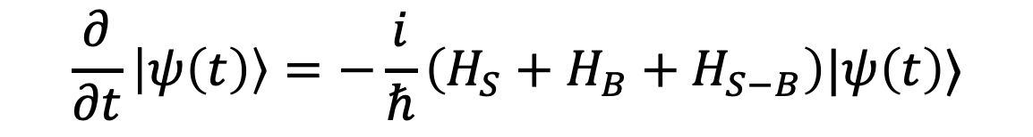



Wavefunction description: Photoinduced Processes in Photosynthesis
Field free Schrödinger equation
$$\frac{∂}{∂t}\left|ψ\left(t\right)\right\rangle =−\frac{i}{ℏ}\left(H_{S}+H_{B}+H_{S−B}\right)|ψ\left(t\right)⟩$$
$$|e_{n}⟩$$
Initial condition
$$\left|ψ_{0}\right\rangle =|g⟩$$
Optical energy gap
$$\left|ψ\left(t_{0}=0_\right)\right\rangle ={|ψ}_{0}⟩|Ξ_{B}⟩$$
$$k_{B}T$$
Wavefunction of the equilibrium bath
Initial state of the electronic system
$$|g⟩$$

Slide 29
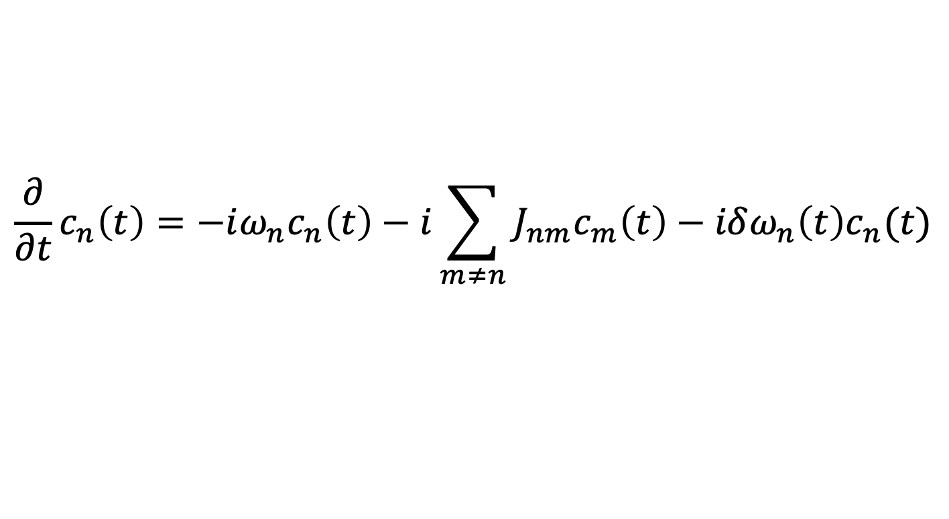
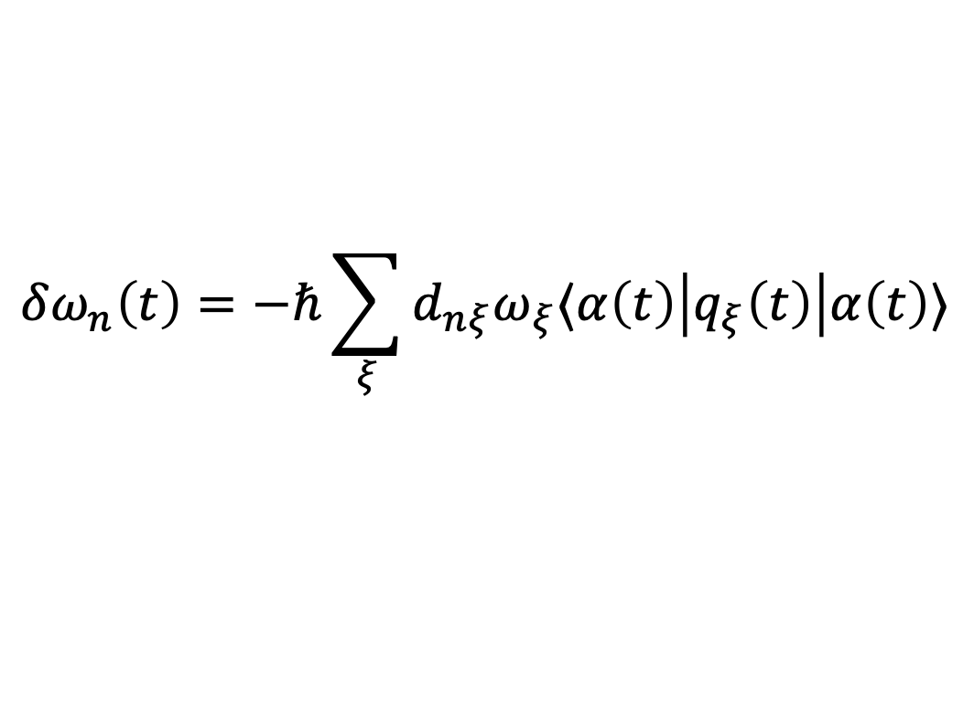
Thermodynamics and Photosynthesis
Equations identical to the classical equations for amplitudes of a set of coupled oscillators
$$\frac{∂}{∂t}c_{n}\left(t\right)=−iω_{n}c_{n}\left(t\right)−i\sum_{m≠n}{J_{nm}c_{m}\left(t\right)}−iδω_{n}\left(t\right)c_{n}(t)$$
$$δω_{n}\left(t\right)=−ℏ\sum_{ξ}{d_{nξ}ω_{ξ}⟨α\left(t\right)\left|q_{ξ}\left(t\right)\right|α\left(t\right)⟩}$$
In a true quantum case,
there is an operator here!
Bath introduces real valued
transition frequency fluctuations
Random fluctuations of the energy gap are unable to produced
finite temperature

Slide 30
Alternative in Molecular Vibrations
Spectral densities full of vibrational contributions
Vibrational modes are omnipresent, but their signatures are “weak”.
Vibrational modes = normal modes, i.e. they have very long coherence lifetime
They interact with electronic degrees of freedom
M. Wendling et al., JPC B 104 (2000) 5825

Slide 31
Vibronic (VIBRational and electrONIC) Coherence
Increase of oscillator strength
is achieved by interaction
with electrons
Interaction is resonant;
there are plenty of modes
available
N. Christensson et al., J. Phys. Chem. B 116 (2012) 7449
A. Chenu et al. Sci. Rep. 3 (2013) 2029
V. Tiwari et al. PNAS 110 (2013) 1203, A. Chin et al. Nature Physics 9 (2013) 113

Slide 32
Excitonic vs. Vibronic Coherence
N. Christensson et al., J. Phys. Chem. B 116 (2012) 7449
Electronic exciton
Vibronic coherence
Explains life-time of dynamic
coherences
but is rather of
the delocalization type
~ 5 % of the SE signal
Vibronic Exciton
Is the case closed?

Slide 33
Coherence, Thermodynamics and Photosynthesis
Spatially coherent motion is an intrinsic property of molecular excitons
Spatial coherence is stable against noise
Coherent component of photosynthetic energy transfer can be
perfectly mapped onto a classical system of oscillators;
experimental signals are not of electronic origin
Thermodynamic behavior (trapping) is a uniquely quantum
feature of photosynthetic antennae
Trapping is enabled by system-bath entanglement

Slide 34



Acknowledgements
Research group
Postdocs (all gone by the end of 2020):
Kieran Fox
Veljko Jankovič
Sue Ann Oh
Funding from Czech Science Foundation (GACR)
Neuron fund – private fund for support of basic science

Slide 35
Thank you for your attention!

